Slide 1

Bonding
What are bonds?
Ionic bonding
Covalent Bonds
NAMING!!!
(MHR Chemistry 11, Section 2.2)

Slide 2

Chemical Bonds

Slide 3
Bonding
Bonds are formed between atoms by the transfer or sharing of electrons
Atoms acquire stable octets by forming bonds (8 electrons). The exception is hydrogen (only 2 e-)
Types of bonding:
  Ionic - metal & non-metal
  Covalent - non-metal & non-metal

Slide 4
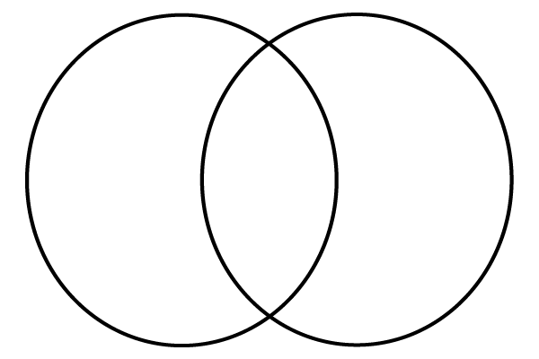
What do we know about bonding?
IONIC BONDING
COVALENT BONDING

Slide 5
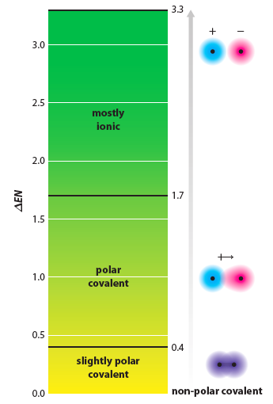
Electronegativity Difference
How do we know if a bond will be ionic or covalent?
Use Electronegativity values!
If the difference is greater than 1.7, the bond is IONIC!

Slide 6
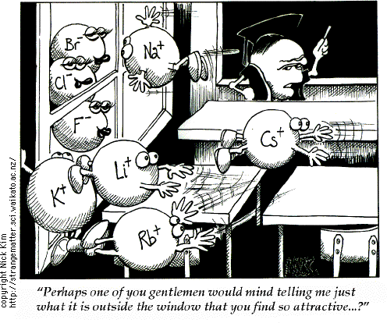
Ionic Bonding
Occurs between a Metal and Non-metal
Transfer of electrons causes ions to be formed
“Bond” is an electrostatic attraction between ions
Difference in electronegativity more than 1.7 between elements

Slide 7
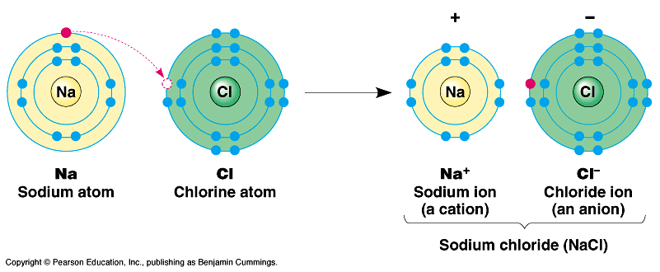
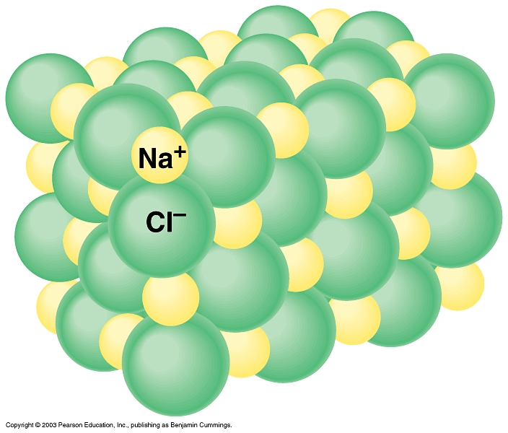
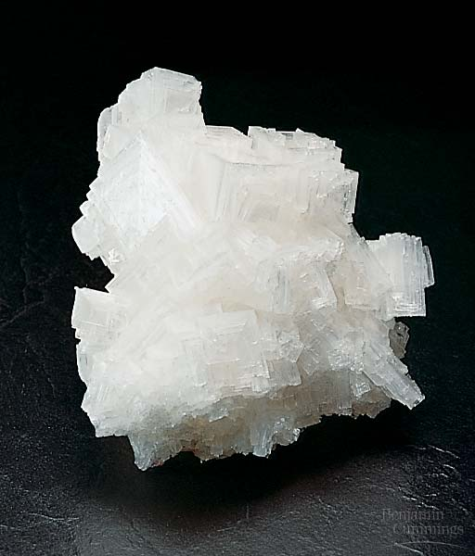

Ionic Bonds – occur when one atom donates or gives up one or more electrons
Opposite charges attract to form ionic bonds
Salt crystals
Ionic Compound ( Na⁺Cl⁻)

Slide 8
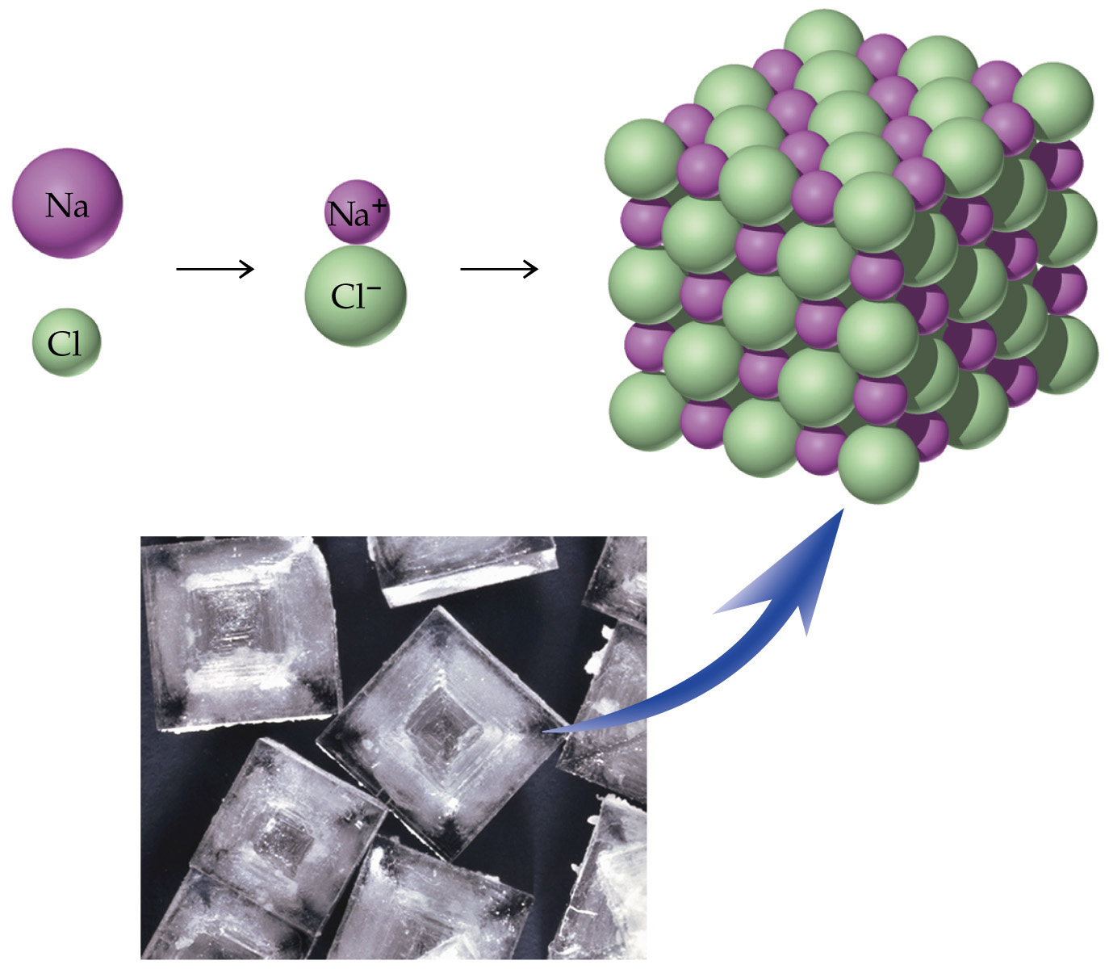
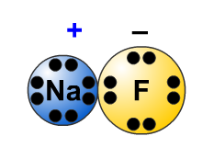
Ionic Bonding
Ionic bonds such as NaCl do not consist of just one Na⁺ ion bonded to one Cl⁻ ion
Ionic bonds represent the relative ratios of these ions in a huge lattice of thousands or millions of ions (i.e. – if there are 5,000 Na⁺ ions, there are 5,000 Cl⁻ ions)

Slide 9
Drawing Lewis Structures of Ionic Compounds
Ionic bonds are electrostatic attractions between cations and anions.
Square brackets must be used around each ion, with charges on the top right hand corner
Binary ionic compounds
  Count electrons for each element
  Transfer electrons accordingly to satisfy octet
Ternary ionic compounds
  Draw Lewis structures for polyatomic ions using covalent rules
  Combine with other half

Slide 10

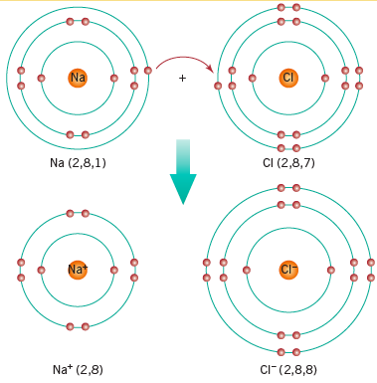
Example
NaCl
[ ]
[ ]⁻
+

Slide 11
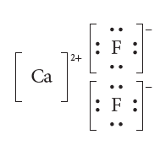
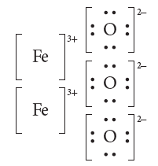
Try it!
Draw Lewis structures to explain the bonding between:
  Ca & F
  Fe₂O₃

Slide 12
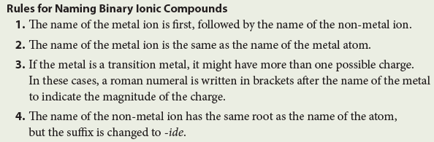
Naming Ionic Compounds
Calcium fluoride
Iron (II) oxide
Iron (III) oxide
CaF₂
FeO
Fe₂O₃

Slide 13
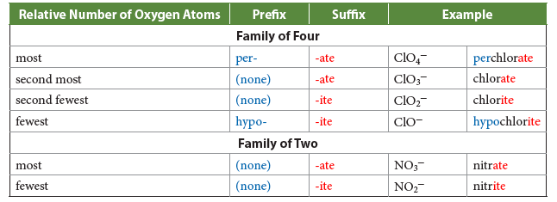
Add in some Polyatomics!
Sodium nitrate
NaNO₃
+1
NORMAL
-1
-2
NaClO₄
Sodium perchlorate
Magnesium chlorate
Lithium chlorite
Calcium hypochlorite
Mg(ClO₃)₂
LiClO₂
Ca(ClO)₂

Slide 14
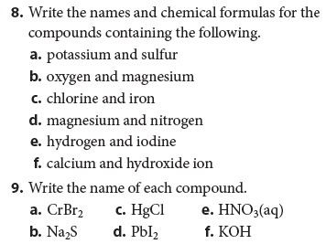
Try it!

Slide 15
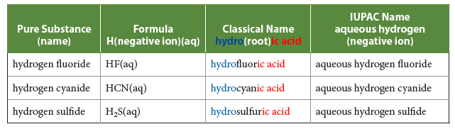
What about acids?
Acids are ionic compounds that have hydrogen in them. They have a special naming system
Acids that don’t have oxygen in them are called BINARY acids.
HCl(aq) is hydrochloric acid
HBr(aq) is hydrobromic acid

Slide 16
Oxoacids
Any acid that has oxygen in it
Named for the polyatomic ion in it, just drop the “ate” and put “ic acid” at the end
H₂SO₄ is sulfuric acid
HNO₃ is nitric acid
H₃PO₄ is phosphoric acid
H₂CO₃ is carbonic acid

Slide 17
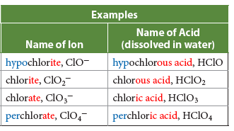
Oxoacids gone wild!
If the oxygens in a polyatomic change, so does the name of the acid
+1 per ______ ic acid
normal ______ ic acid
-1 ______ ous acid
-2 hypo ______ ous acid

Slide 18
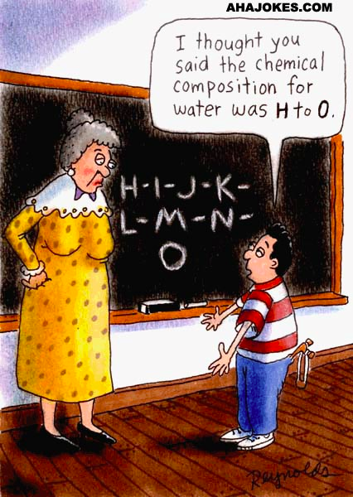
Covalent
Non-metal and non-metal
Sharing of electrons
No ions formed in the process
Bond is shared electrons between the two atoms (2, 4 or 6 electrons)
Difference in electronegativity less than 1.7

Slide 19
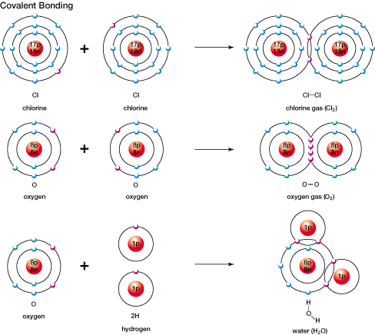
Covalent Bonds – involve a sharing of a pair of valence electrons between atoms.

Slide 20
2 Types of Covalent Bonds
Polar Covalent
Non-polar covalent
Unequal sharing
of electrons
Equal sharing
of electrons
E.g., H₂
O₂
Determined by the atoms
ELECTRONEGATIVITY
21

Slide 21
Covalent vs. Polar covalent
4.0
IONIC
1.7
POLAR COVALENT
0.3
0
NON-POLAR
Between 0.0 – 0.3 non-polar covalent bond – bonding electrons are shared equally
(H₂, N₂, O₂, F₂, Cl₂ , Br₂, I2) – they form a “7” on the table.
between 0.3 – 1.7 polar covalent bond – the more electronegative atom attracts the shared electron pair more strongly than the less electronegative atom (ex: HCl)

Slide 22

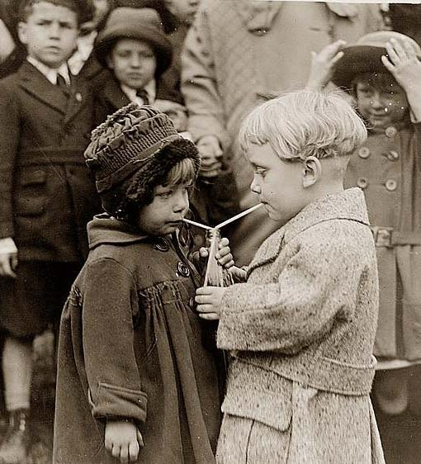
The boy is not equally sharing with anyone else but rather taking all the food for himself.
Non-polar covalent
The children are equally sharing the drink between themselves.
Polar Covalent
24

Slide 23
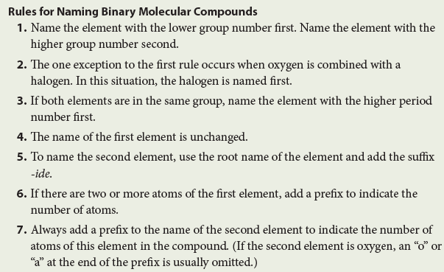
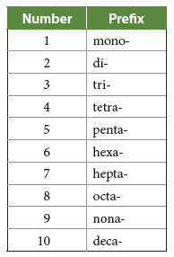
Naming Molecular Compounds
N₂O
PCl₅
Cl₂O₇
Dinitrogen monoxide
Phosphorous pentachloride
Dichlorine heptaoxide

Slide 24
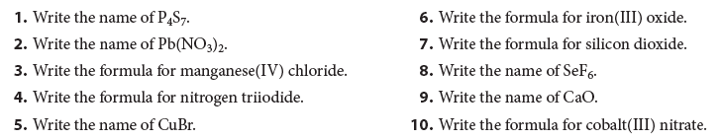
Try it!

